Slide 1

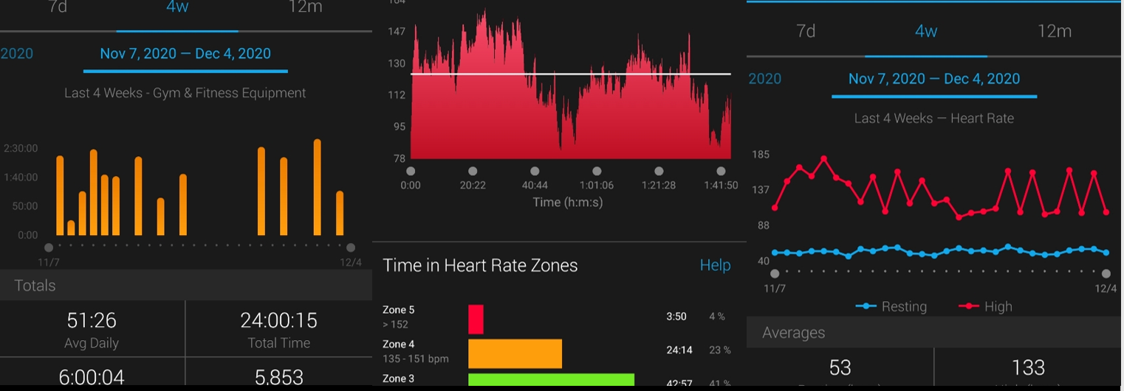

Apple health dashboard
A visualization tool to help clinicians interpret patient exercise data
Brandon Lade
Jacqueline Warren

Slide 2
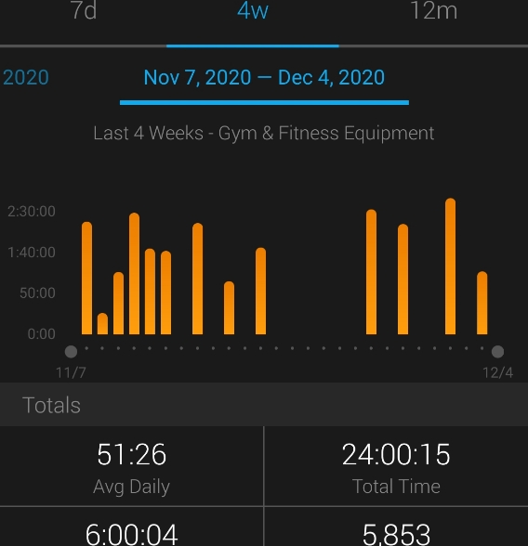
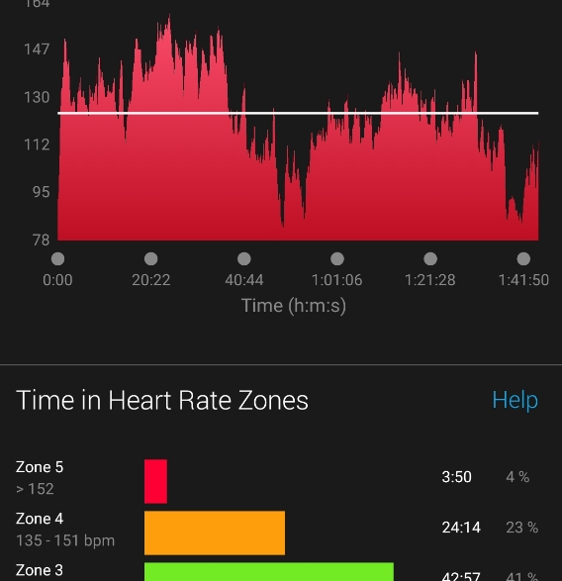
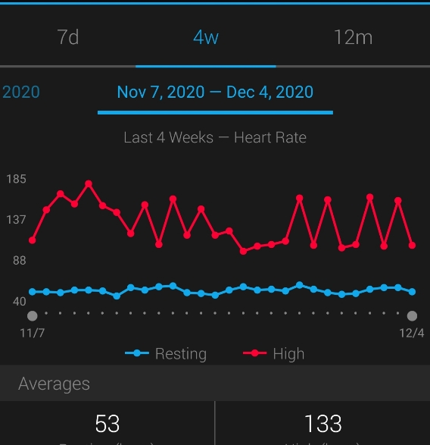
Dashboards

